Slide 1
How to analyse continuous bounded variables?
Michail Belias
Department for Health Evidence

Slide 2
How would one perform an analysis with a bounded dependent variable?
Y $∈($a, b) or Y $∈($0, 1)
Y ∈(a, b) or Y ∈(0, 1)
Transform the data
$\tilde{Y}= g(Y)$ ~ $\tilde{Y}$ $∈$ S ⊆ ℝ
Transform the data
𝑌 ̃= 𝑔(𝑌) ~ 𝑌 ̃ ∈ S ⊆ ℝ
logit transformation
Arcsine-square root transformation

Slide 3
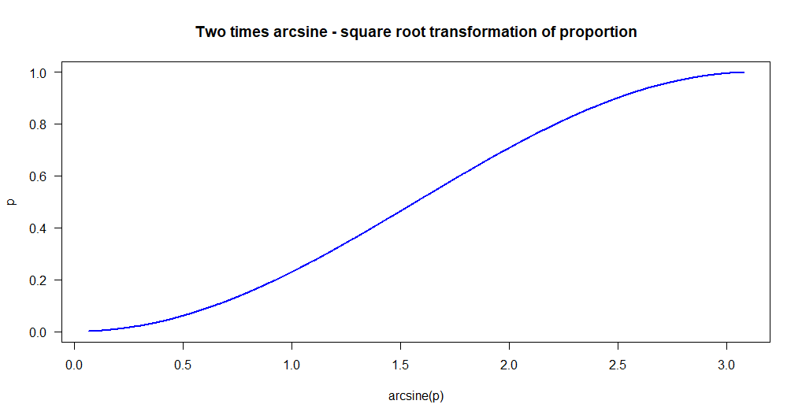
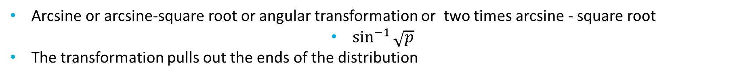
Arcsine-square root transformation
Arcsine or arcsine-square root or angular transformation or two times arcsine - square root
$\sin^{−1}{\sqrt{p}}$
The transformation pulls out the ends of the distribution

Slide 4
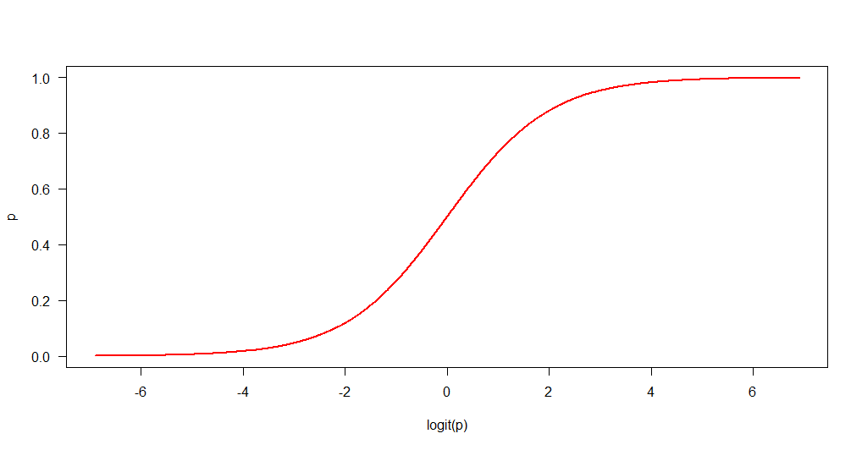
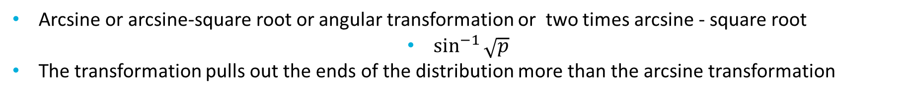
logit transformation
Arcsine or arcsine-square root or angular transformation or two times arcsine - square root
$\sin^{−1}{\sqrt{p}}$
The transformation pulls out the ends of the distribution more than the arcsine transformation

Slide 5
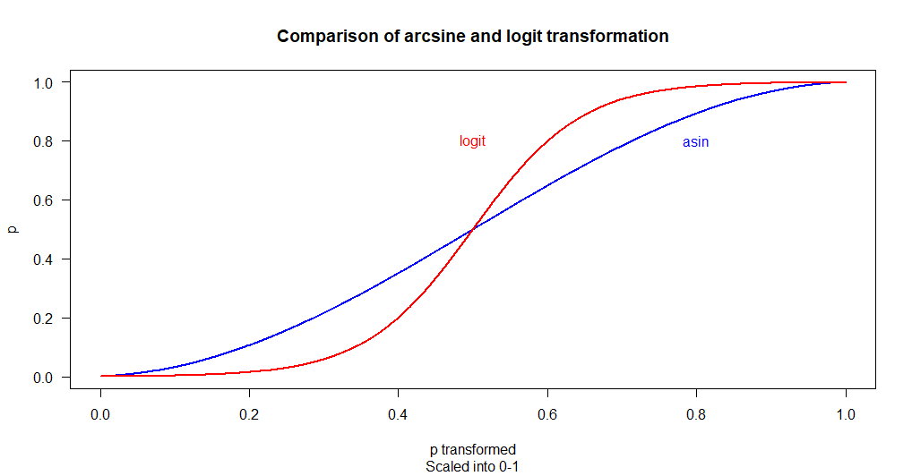
Comparison of effects
The difference in the effect of the transformation is better shown on the same scale

Slide 6
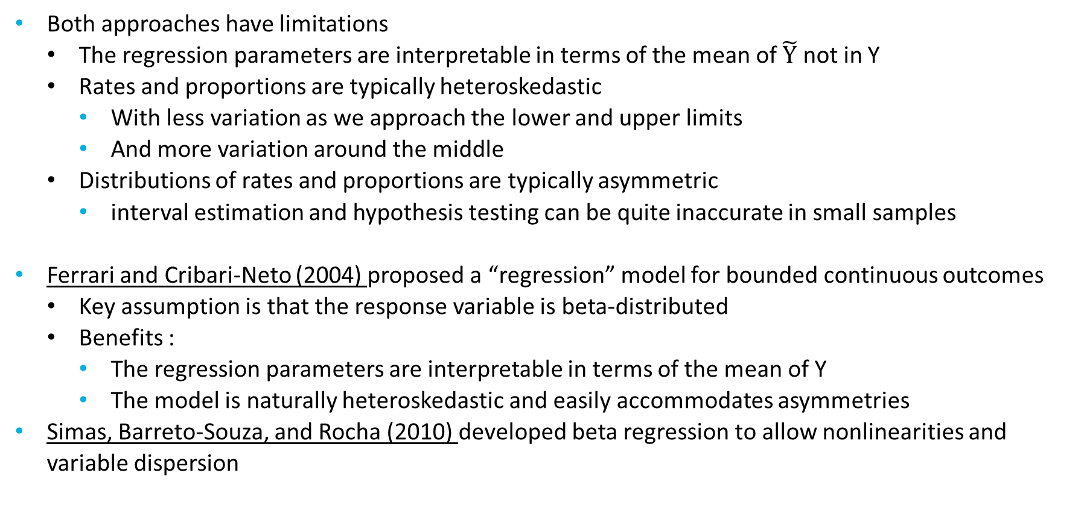
Different point of view
Both approaches have limitations
The regression parameters are interpretable in terms of the mean of $\tilde{Y}$ not in Y
Rates and proportions are typically heteroskedastic
With less variation as we approach the lower and upper limits
And more variation around the middle
Distributions of rates and proportions are typically asymmetric
interval estimation and hypothesis testing can be quite inaccurate in small samples
Ferrari and Cribari-Neto (2004) proposed a “regression” model for bounded continuous outcomes
Key assumption is that the response variable is beta-distributed
Benefits :
The regression parameters are interpretable in terms of the mean of Y
The model is naturally heteroskedastic and easily accommodates asymmetries
Simas, Barreto-Souza, and Rocha (2010) developed beta regression to allow nonlinearities and variable dispersion

Slide 7
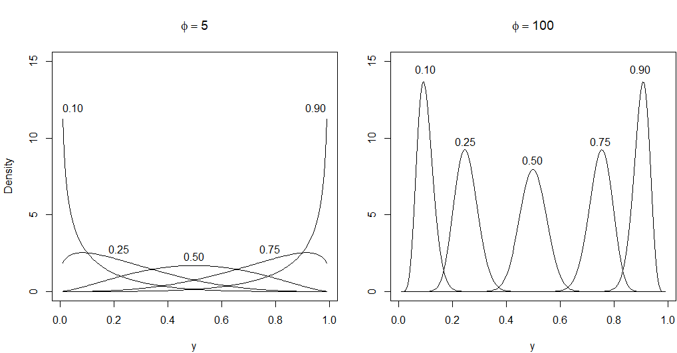
Beta distribution
Probability density functions for beta distributions with varying parameters

Slide 8
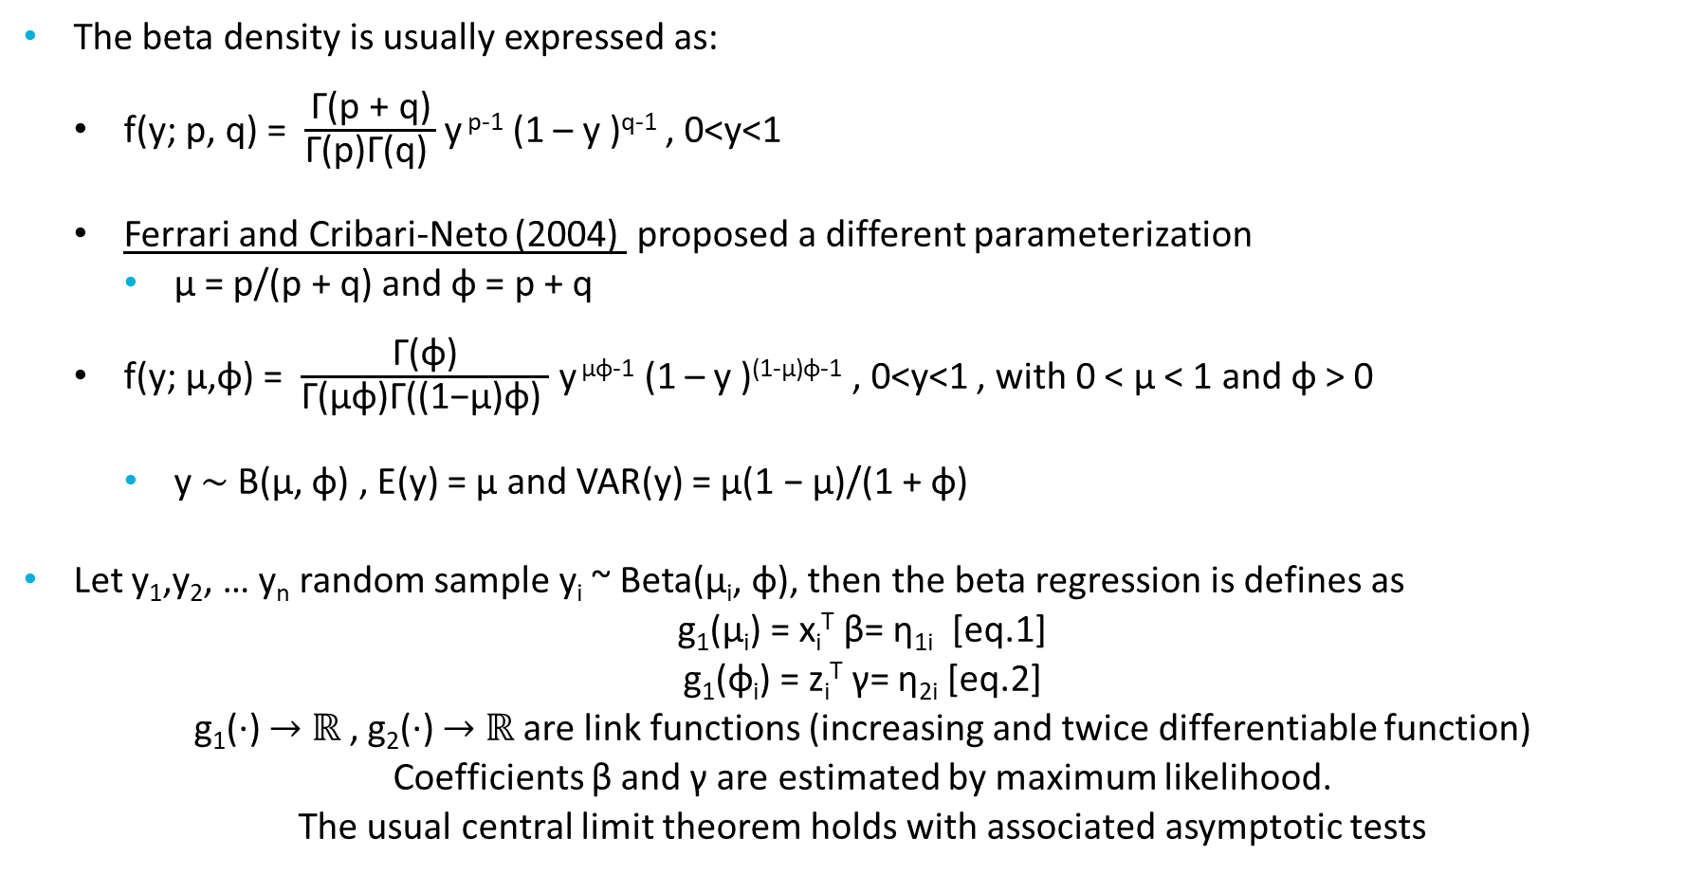
Beta regression models
The beta density is usually expressed as:
f(y; p, q) = $\frac{\text{Γ}\text{(}\text{p}\text{ + }\text{q}\text{)}}{\text{Γ}\text{(}\text{p}\text{)}\text{Γ}\text{(}\text{q}\text{) }}$ y ^{p-1} (1 – y )^{q-1} , 0<y<1
Ferrari and Cribari-Neto (2004) proposed a different parameterization
µ = p/(p + q) and φ = p + q
f(y; μ,φ) = $\frac{\text{Γ}\text{(}\text{φ}\text{)}}{\text{Γ}\text{(}\text{μφ}\text{)}\text{Γ}\text{(}\text{(1−}\text{μ}\text{)}\text{φ}\text{) }}$ y ^{μφ-1} (1 – y )^{(1-μ)φ-1} , 0<y<1 , with 0 < µ < 1 and φ > 0
y ∼ B(µ, φ) , E(y) = µ and VAR(y) = µ(1 − µ)/(1 + φ)
Let y₁,y₂, … y_{n} random sample y_{i} ~ Beta(μ_{i}, φ), then the beta regression is defines as
g₁(μ_{i}) = x_{i}^{T} β= η_{1i} [eq.1]
g₁(φ_{i}) = z_{i}^{T} γ= η_{2i} [eq.2]
g₁(·) $→$ ℝ , g₂(·) $→$ ℝ are link functions (increasing and twice differentiable function)
Coefficients β and γ are estimated by maximum likelihood.
The usual central limit theorem holds with associated asymptotic tests
Notes:
The main motivation for using a link function in the regression structure is twofold.
First, both sides of the regression equation assume values in the real line when a link function is applied to i.
Second, there is an added flexibility since the practitioner can choose the function that yields the best fit.
log, logit , probit , complementary log-log, log-log and Cauchy for the mean
"identity", "log", and "sqrt“ for the precision.

Slide 9
Implementation in R
The function used is betareg()
Similar to the glm() function.
A main difference is that two equations may be calculated (one for mean and one for precision)
formula = y ~ x1 + x2 | 1 + z1 + z2 + z3
In the above example the x₁ + x₂ are the regressors for mean modelling [eq.1]
While the z₁ + z₂ + z₃ are the regressors for the precision equation [eq.2]
formula = y ~ x1 + x2

Slide 10
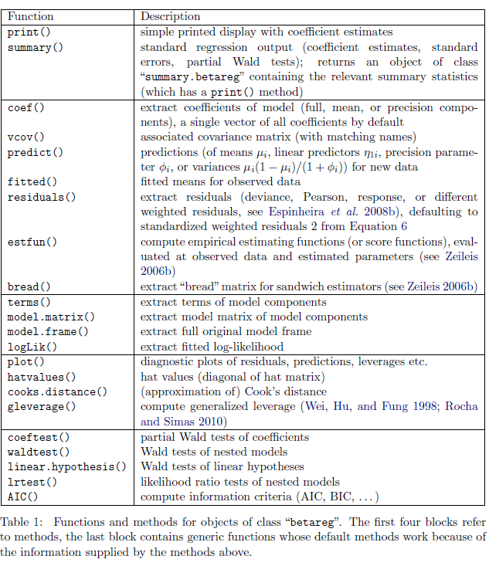

Slide 11
Examples
Reading accuracy data for nondyslexic and dyslexic Australian children (Smithson and Verkuilen 2006)
We model the reading accuracy given dyslexia and IQ with interaction
arcsine transformation
Estimate Std. Error t value Pr(>|t|)
(Intercept) 1.071217 0.029041 36.8862 < 2.2e-16 ***
dyslexia -0.188236 0.029041 -6.4817 9.946e-08 ***
iq 0.041216 0.028993 1.4216 0.16290
dyslexia:iq -0.056415 0.028993 -1.9458 0.05872 .
logit transformation
Estimate Std. Error t value Pr(>|t|)
(Intercept) 1.60107 0.22586 7.0888 1.411e-08 ***
dyslexia -1.20563 0.22586 -5.3380 4.011e-06 ***
iq 0.35945 0.22548 1.5941 0.11878
dyslexia:iq -0.42286 0.22548 -1.8754 0.06805 .
Both interactions were statistically not significant

Slide 12
Examples (continued)
When overdispersion is accounted the interactions become significant
Estimate Std. Error z value Pr(>|z|)
(Intercept) 1.12323 0.15089 7.4441 9.758e-14 ***
dyslexia -0.74165 0.15145 -4.8969 9.736e-07 ***
iq 0.48637 0.16708 2.9109 0.0036034 **
dyslexia:iq -0.58126 0.17258 -3.3681 0.0007568 ***
(phi)_(Intercept) 3.30443 0.22650 14.5890 < 2.2e-16 ***
(phi)_dyslexia 1.74656 0.29398 5.9410 2.832e-09 ***
(phi)_iq 1.22907 0.45957 2.6744 0.0074862 **
---
Signif. codes: 0 ‘***’ 0.001 ‘**’ 0.01 ‘*’ 0.05 ‘.’ 0.1 ‘ ’ 1

Slide 13
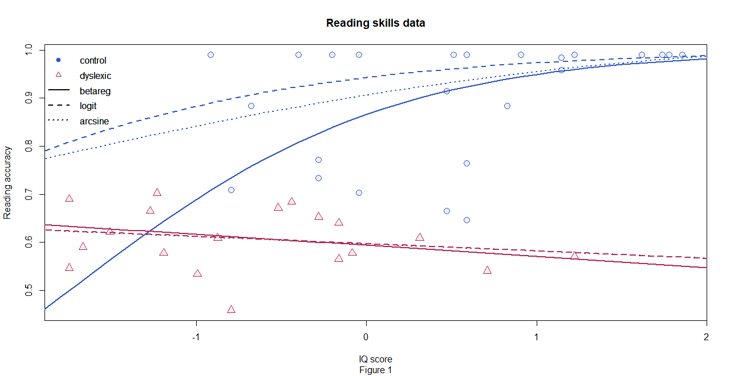
How do the models fit?

Slide 14
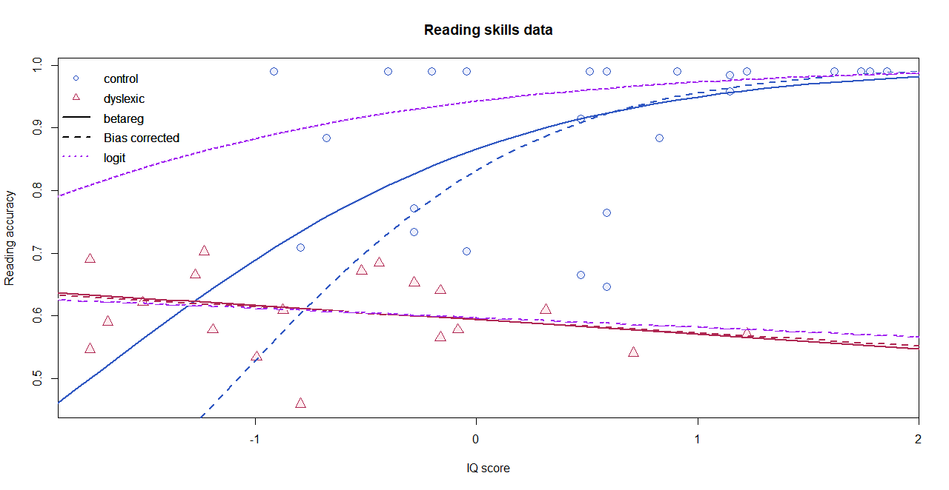
Care on the ML estimation
Kosmidis and Firth (2010) showed that ML inference may be severely biased in the context of beta regression
Therefore, bias corrected and bias reduced addons are imported and called through the option
type = c("ML", "BC", "BR")

Slide 15
Small bonuses
Beta regression trees are also possible using the betatree a modified glmtree from partykit package.
The MOB (Model based recursive partitioning) approach:
Fitting a beta regression model
Assessing whether its parameters are stable across all partitioning variables
Splitting the sample along the partitioning variable associated with the highest parameter instability
Repeating these steps until some stopping criterion is met

Slide 16
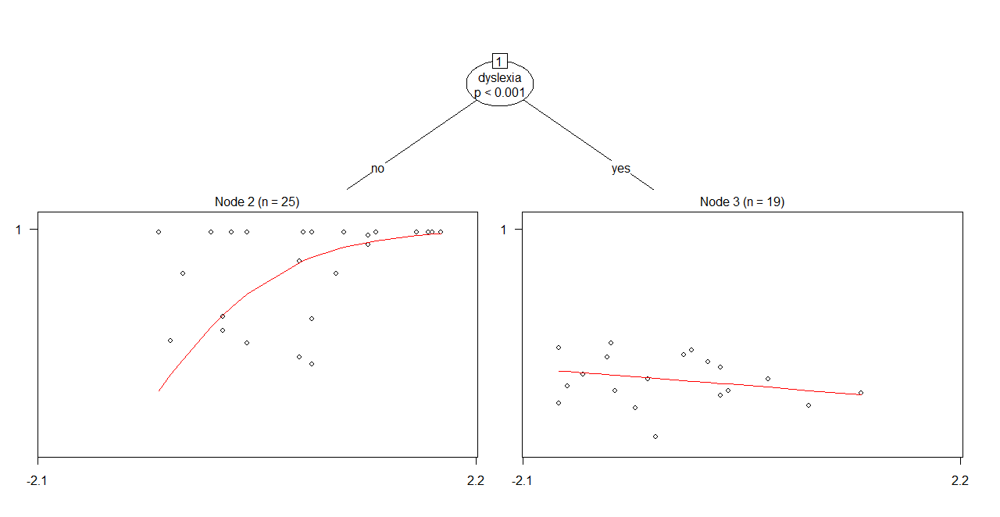
Betatree

Slide 17
Latent class beta regression
If we didn’t know dyslexia and we were suspecting underlying latent classes

Slide 18
References
[1] Silvia Ferrari & Francisco Cribari-Neto (2010) Beta Regression for Modelling Rates and Proportions, Journal of Applied Statistics, 31:7, 799-815, DOI: 10.1080/0266476042000214501
[2] Simas, Alexandre & Barreto-Souza, Wagner & V. Rocha, Andréa. (2010). Improved estimators for a general class of beta regression models. Computational Statistics & Data Analysis. 54. 348-366. 10.1016/j.csda.2009.08.017.
[3] Kosmidis I, Firth D (2010). \A Generic Algorithm for Reducing Bias in Parametric Estimation."
Electronic Journal of Statistics, 4, 1097{1112.

